Slide 1
CYCLE COUNTING
OF
INVENTORY ITEMS
Subtitle
Date
05-Sep-2015
Sushanta Chakrabarty

Slide 2
CYCLE COUNTING Vs PHYSICAL INVENTORY
Cycle Counting or Physical Inventory Counting is used to streamline the inventory of the items within warehouse and system (that is to tally the actual inventory and the on hand in system).
Physical inventory is a process where a business physically counts its entire inventory and it is done once, twice or four times a year to check and correct the accuracy of your inventory.
Cycle counting, an alternative to physical inventory, may be less disruptive. It is an inventory auditing procedure, where a small subset of inventory, in a specific location, is counted on a specified day.
There are several methods of selecting the items to count, when and how many times to count. Each method has strengths and weaknesses.
        ABC Analysis : Most popular & used widely.
        Pareto Method: cycle count by % of periodic inventory value (cost X usage).
        Cycle counting by usage only: Items more frequently accessed should be counted more often, irrespective of value. Distinguish items depending on how frequently It’s touched.
        Hybrid: This method requires manual arrangement and is not effective since arbitrary adjustments can be made.

Slide 3
CYCLE COUNTING Vs PHYSICAL INVENTORY
Why Cycle Counting and why not Physical Inventory. What are the advantages & disadvantages.
SL # | Cycle Counting | Physical inventory
1 | Items can be selected using ABC Analysis | It is done for all most all items
2 | Can be done on specific or selective items | It is done for all most all items
3 | Can be done multiple times in a year | Done once or twice in a year
4 | Count can be scheduled | Can not be scheduled. Specific time of a year.
5 | Can not have a snap shot | Can have a snap shot
6 | Quantity can be viewed in system | Quantity can not be viewed
7 | Inventory transactions need not be frozen | Inventory transactions need to be frozen
8 | Recount is possible | Recount is generally not possible
9 | Recount history can be maintained | No recount, hence no history
10 | Adjustment can be processed on approval | Use Concurrent Program to process transaction

Slide 4
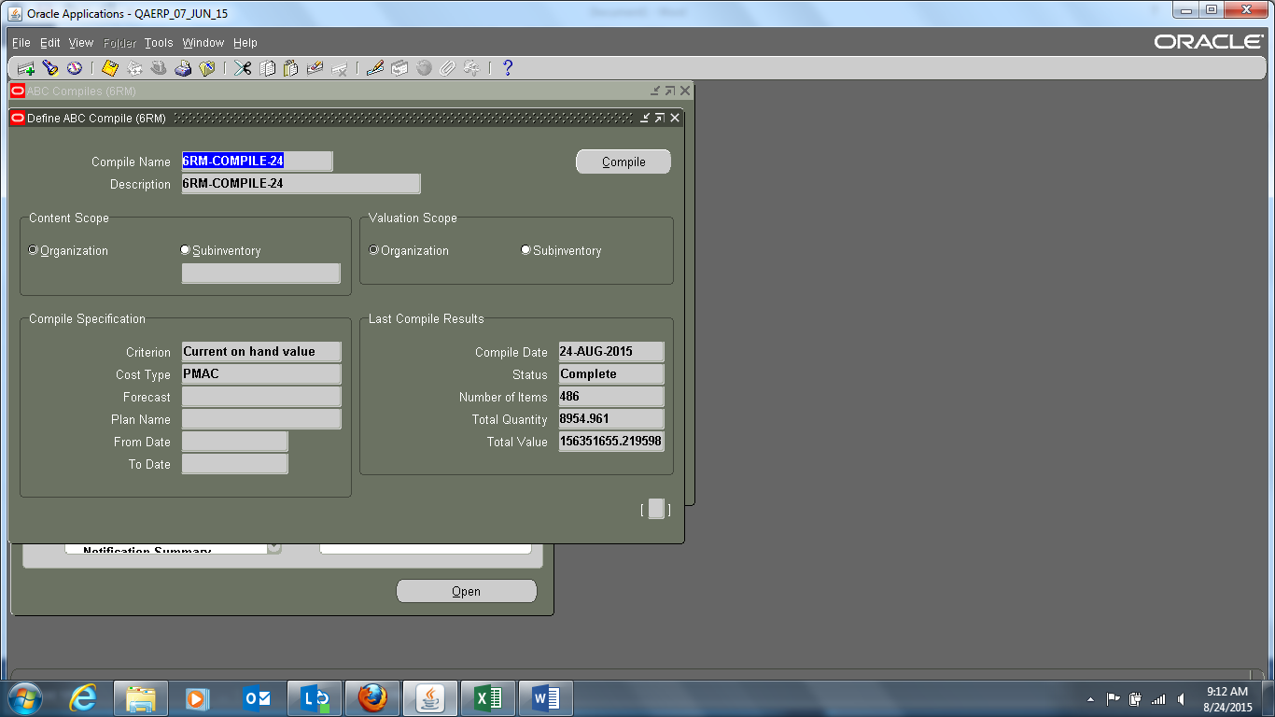
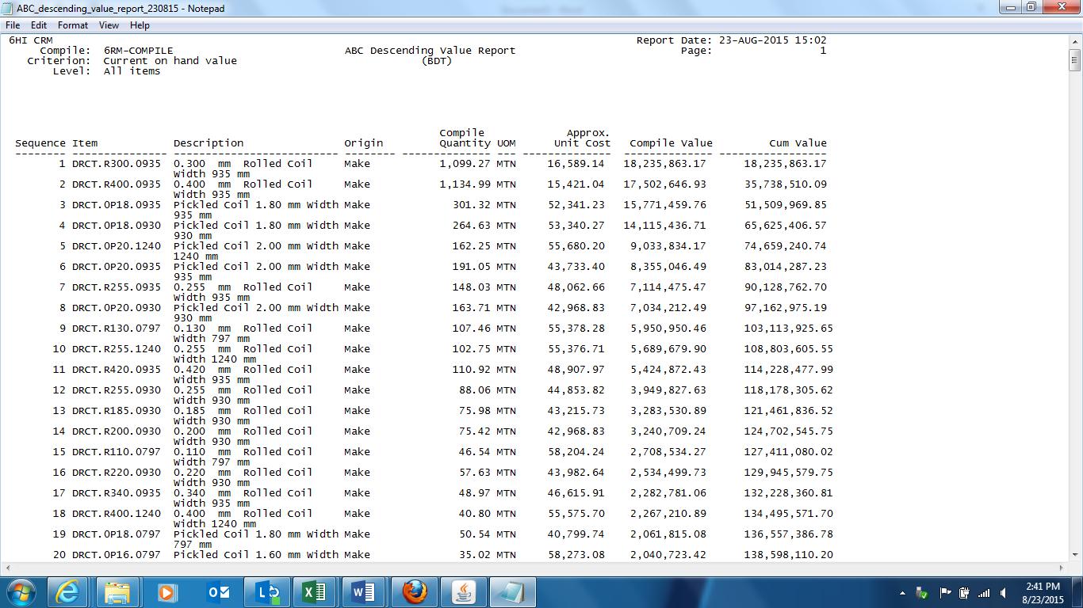
CYCLE COUNTING – ABC ANALYSIS
ABC Analysis:
Compile ABC Analysis using Define ABC Compile Screen.
View ‘ABC descending value report’ - Items are in the descending order of value or quantity as specified.

Slide 5
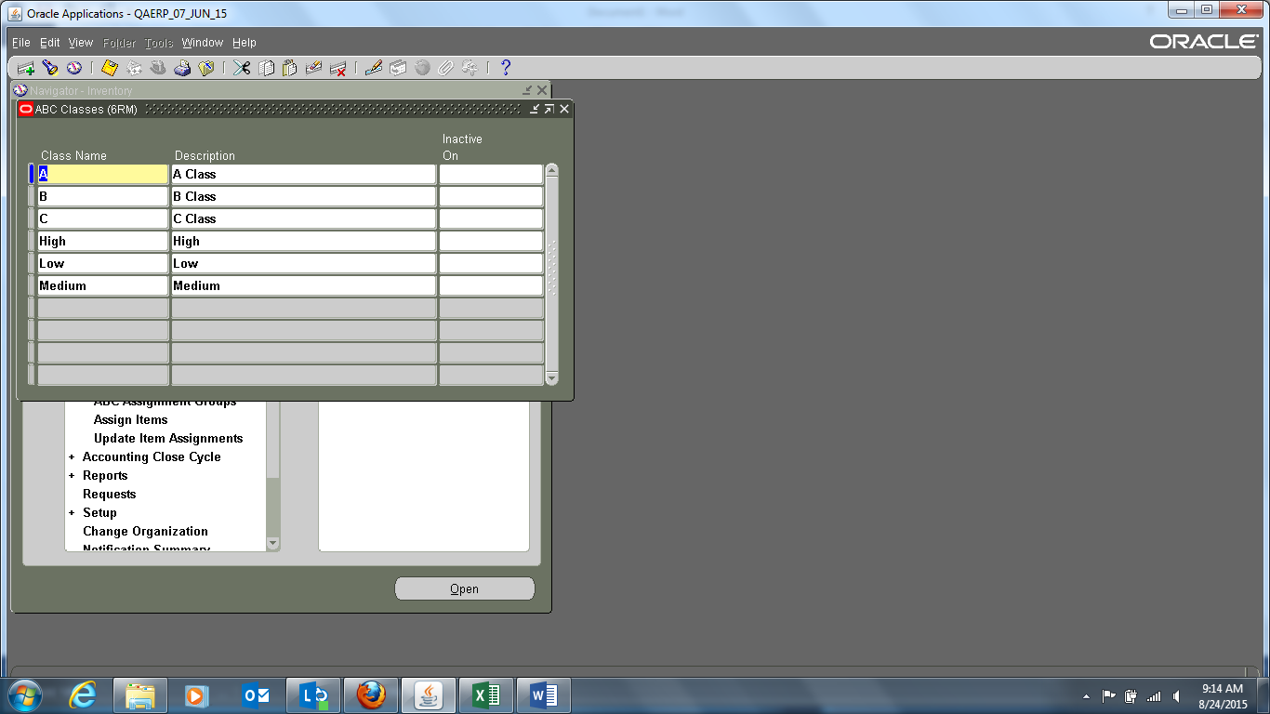
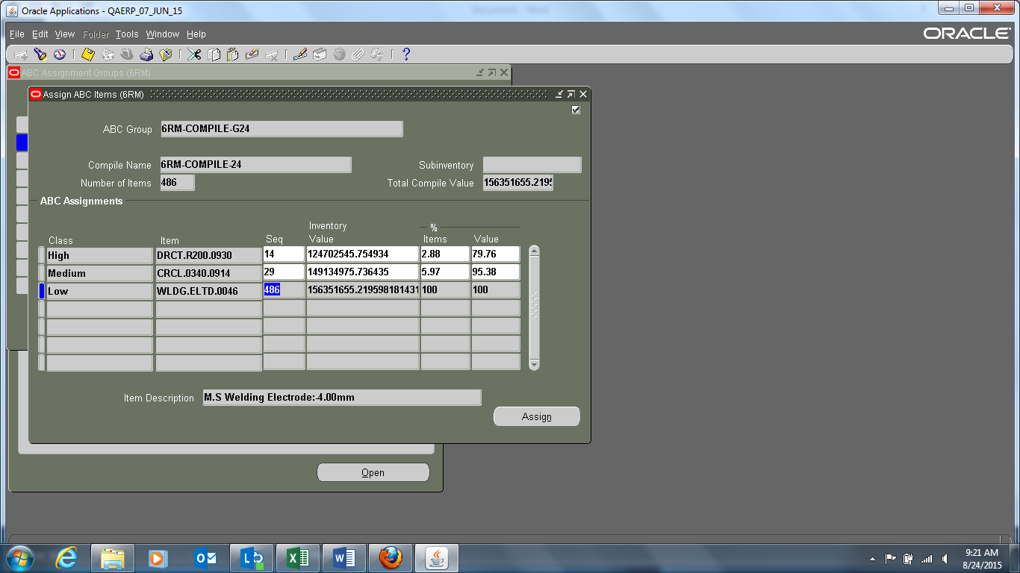
CYCLE COUNTING – ABC ANALYSIS
ABC Class & ABC Assignment Groups:
Define ABC Classes as A, B, C or High, Medium, Low as desired. The nomenclature should be unique. Assign the ABC Classes with the ABC Compile Name.
Assign the items to a class under a group

Slide 6
CYCLE COUNTING – SETUP PARAMETERS
Define New Cycle Count:
Against a unique Cycle Count Name, Calendar, Adjustment Account define parameters like:
SL #, | Tab | Parameters
1 | Scope & Control | Late Days, Start Sequence Number, Unscheduled Entries, Display System Quantity, Automatic Recount with Max. No and All Sub-inventories or a few specific.
2 | Serial & Schedule | Serial Control Options for: Count, Detail (Quantity & / or Serial #), Adjustments, Discrepancy, Auto Schedule Frequency , Count Zero Quantity
3 | Adjustment & ABC | Approval Required (Never / Tolerance / Always) Tolerances (Qty. Variance %, Adjustment Value, Hit/ Miss Analysis), AB Initialization Group , Options ( None, (Re)initialize, Update)
4 | Cycle Count Class | Counting Frequency per year, Approval Variance in (+ , - )(Qty. Variance %, Adjustment Value, Hit/ Miss %),
5 | Cycle Item Class | To Load Items into Cycle Count. Specify ABC Group from which the items are loaded. Manually enter, update or delete items to be included in cycle count

Slide 7
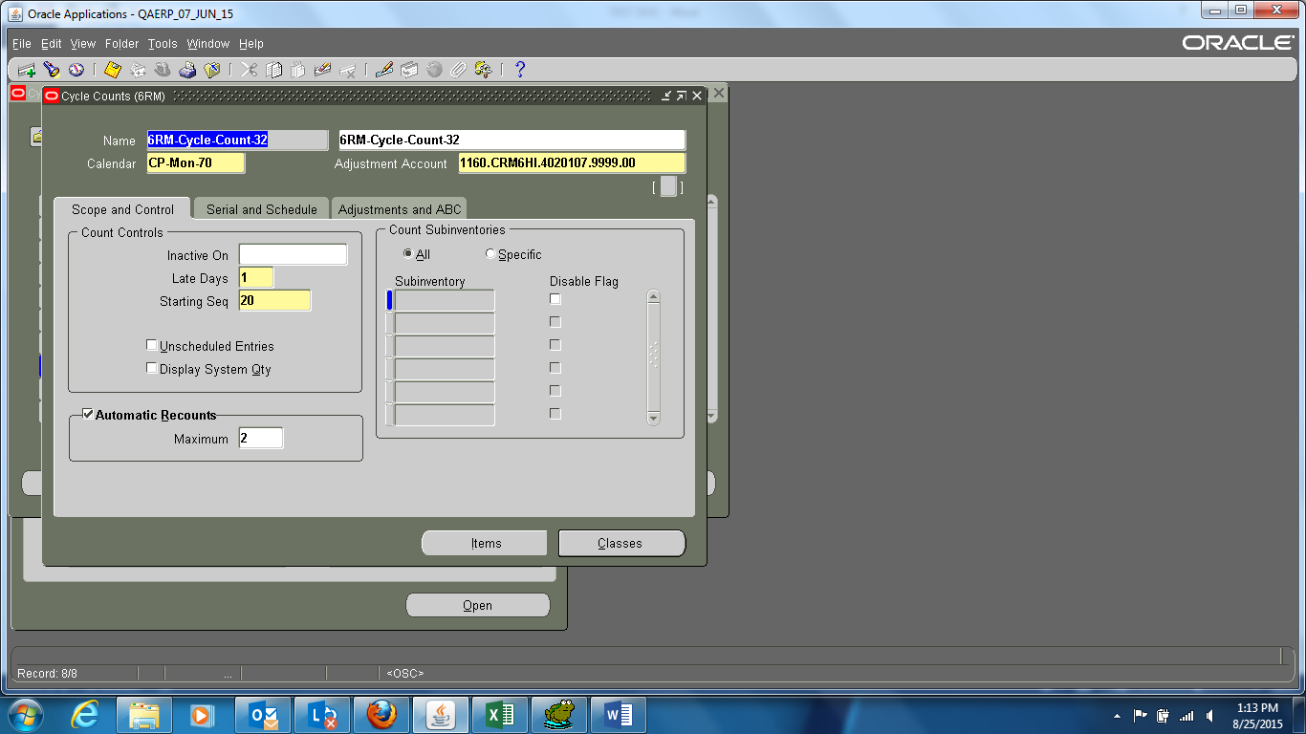
CYCLE COUNTING – SETUP PARAMETERS
Scope & Control:

Slide 8
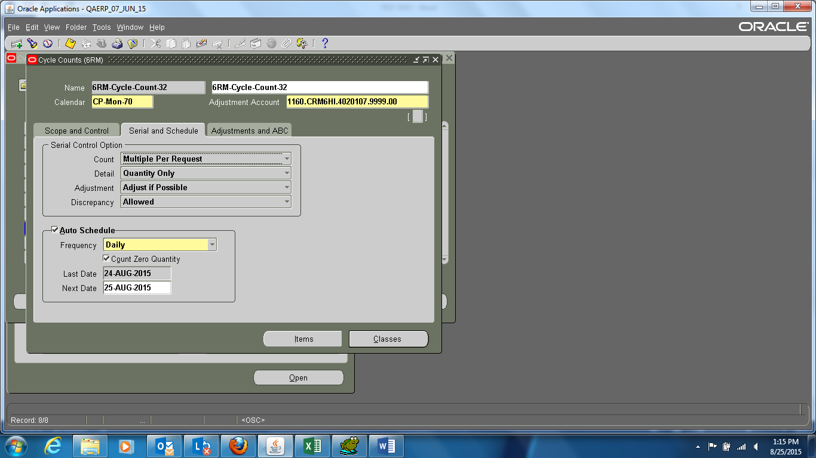
CYCLE COUNTING – SETUP PARAMETERS
Serial & Schedule:

Slide 9
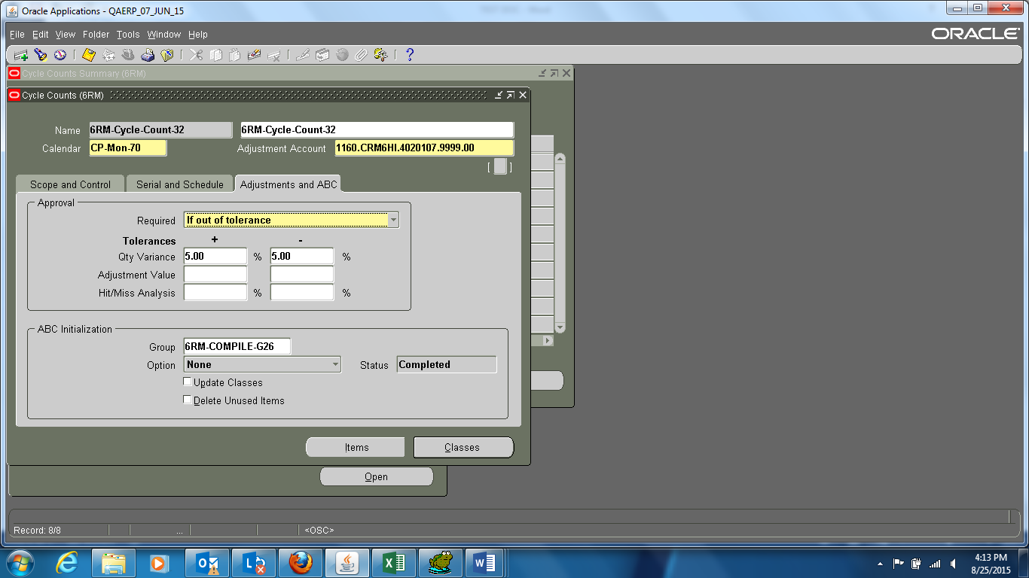
CYCLE COUNTING – SETUP PARAMETERS
Adjustment & ABC:

Slide 10
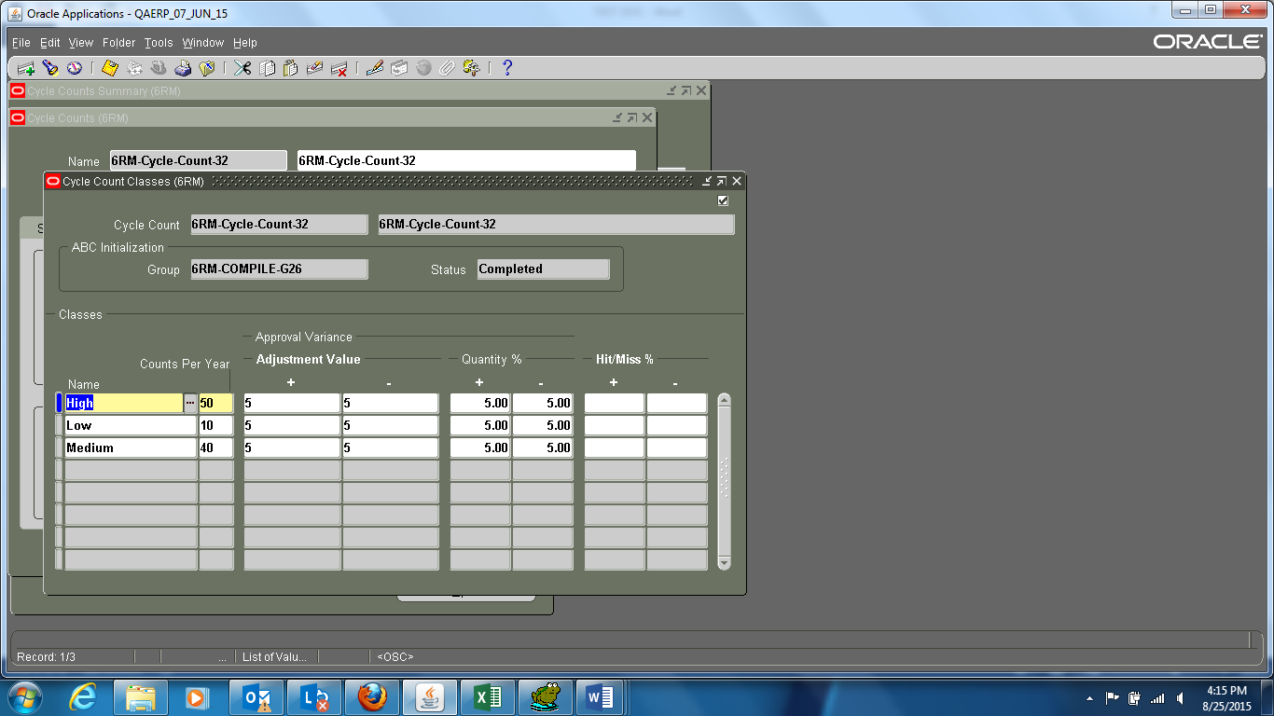
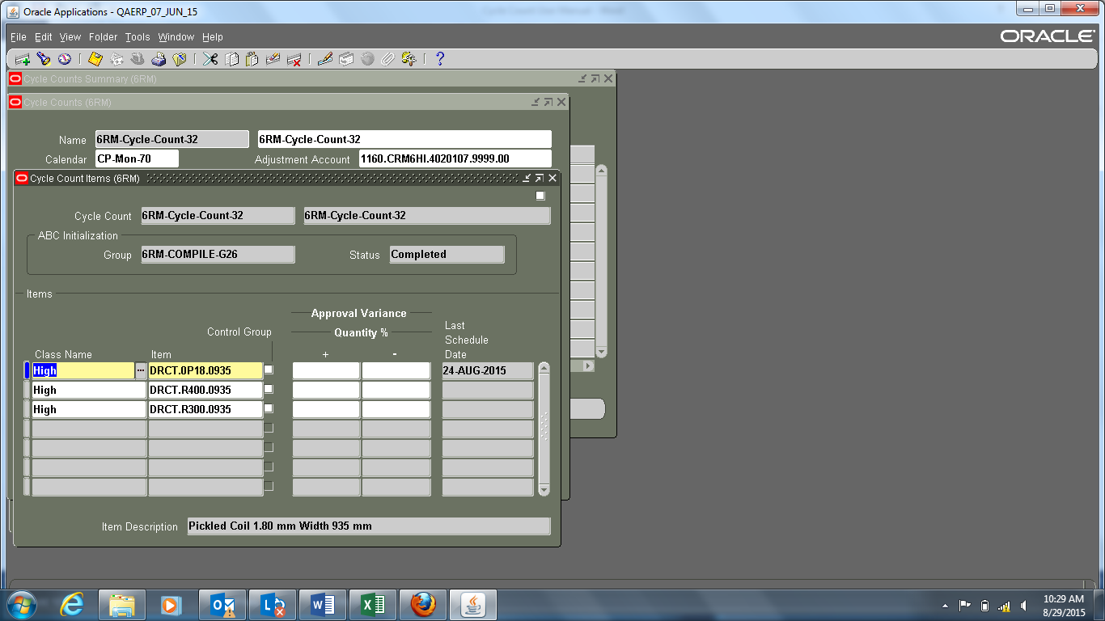
CYCLE COUNTING – SETUP PARAMETERS
Cycle Count Class:
Cycle count Items:

Slide 11
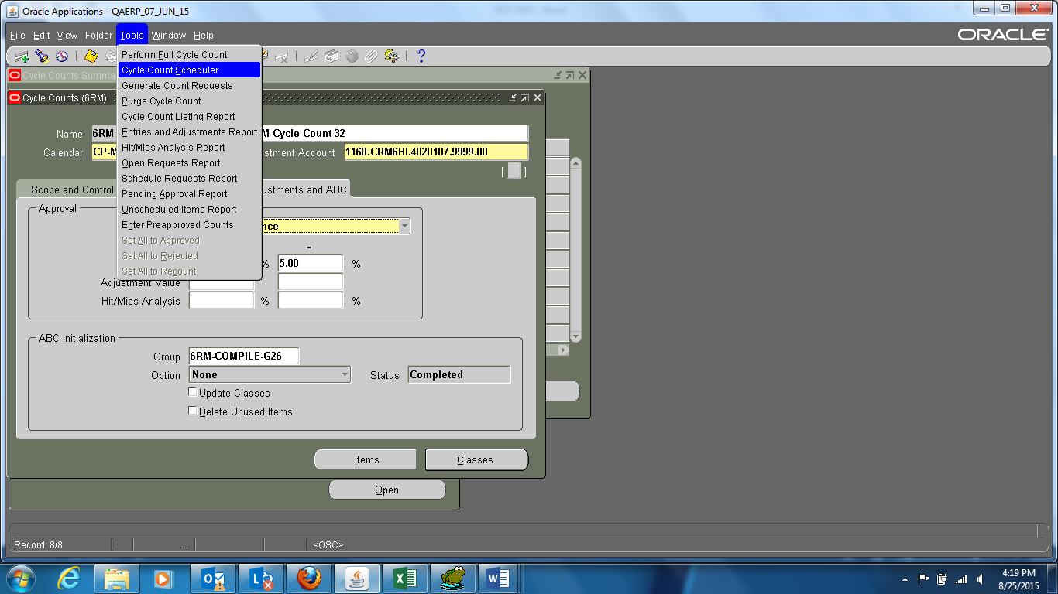
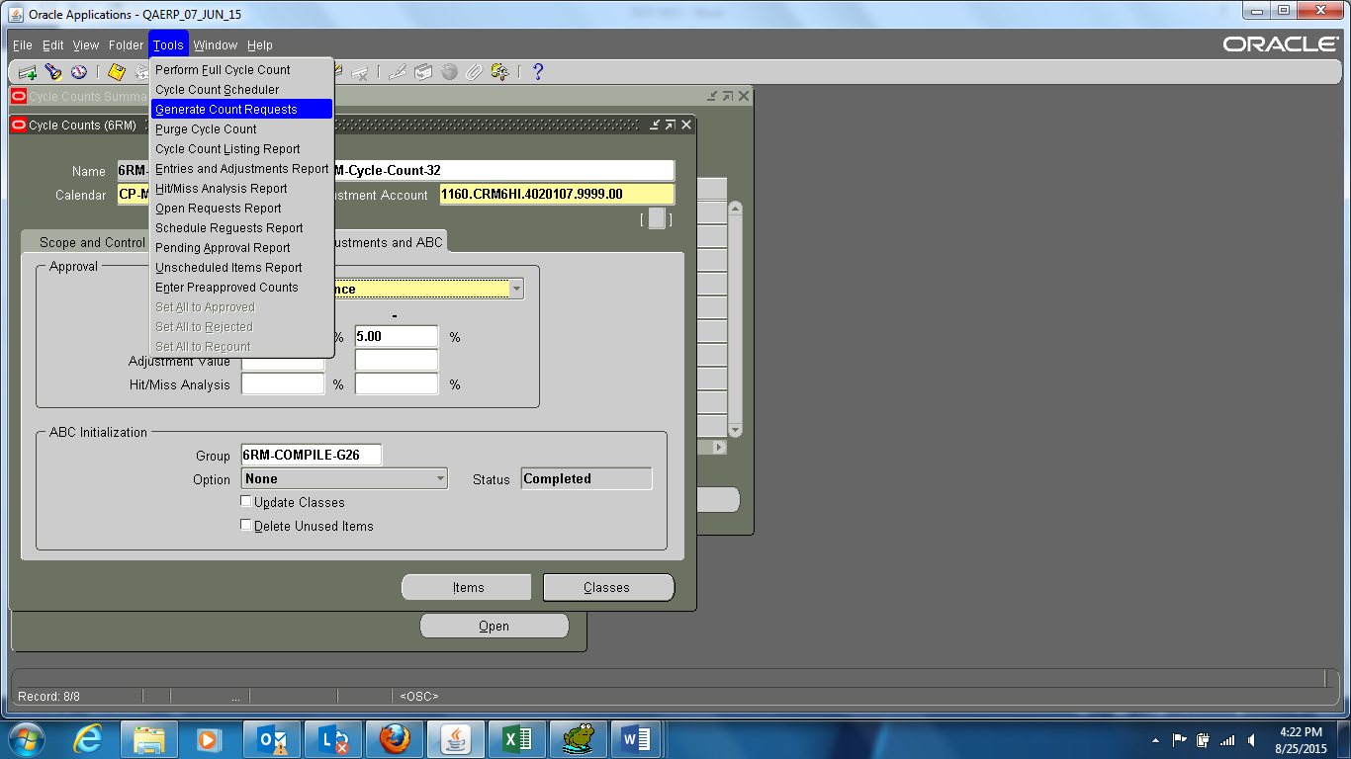
CYCLE COUNTING – SETUP PARAMETERS
Generate Automatic Schedules:
Run Cycle Count Scheduler from Tools Menu
Run Generate Count Request from Tools Menu

Slide 12
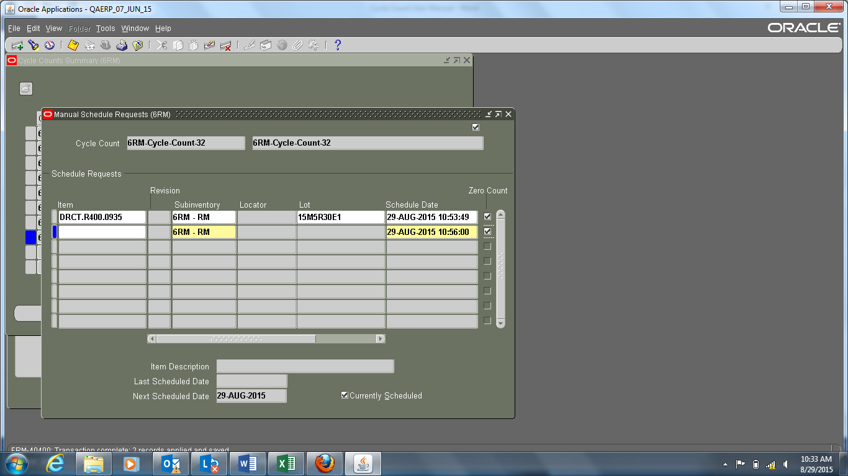
CYCLE COUNTING – SETUP PARAMETERS
Generate Manual Schedule Cycle Count Requests:
Enter Cycle Count for Scheduling . Select Item , Sub-inventory (if required for this sub-inventory)
Enter date to be scheduled

Slide 13
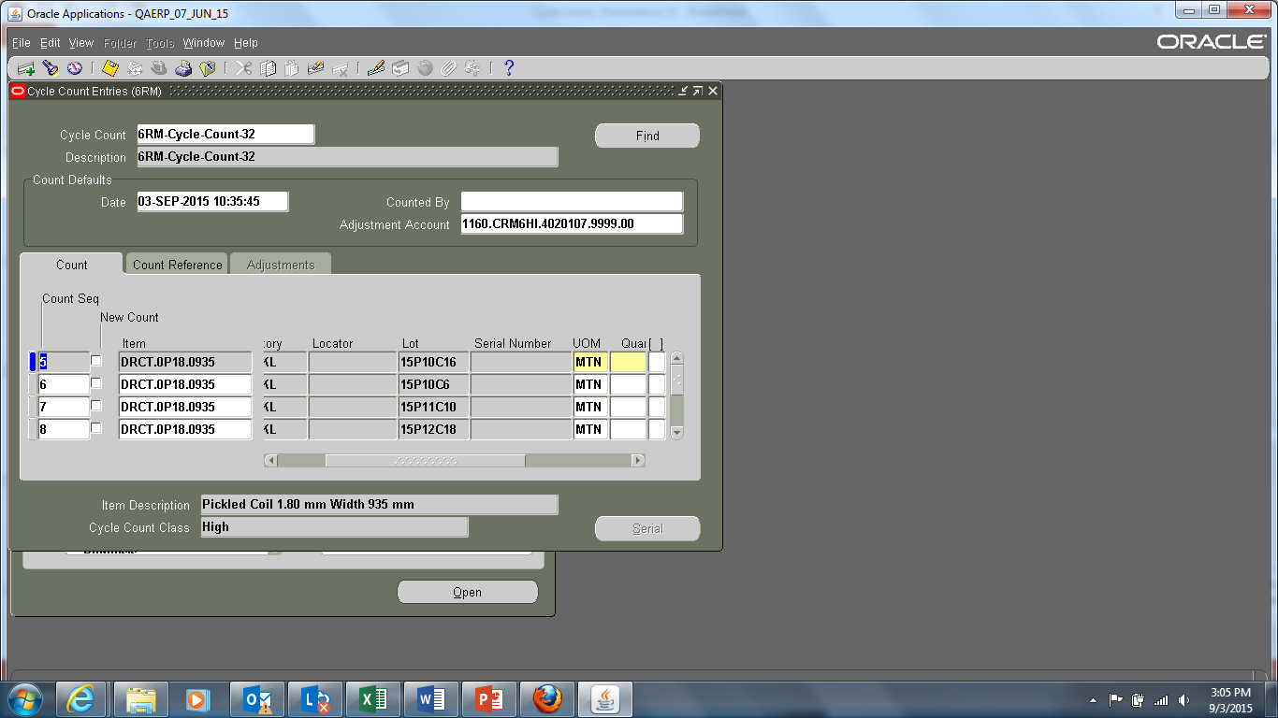
CYCLE COUNTING – ENTER PHYSICAL COUNT
Entering Cycle Counts
Navigate to the Cycle Count Entries window for a Cycle Count name and Display the count requests to be entered. Choose the Find button to query all open count requests.
Enter Date, Name of employee who performed Cycle Count.
Enter the count quantity for the item. Inventory uses this quantity with the specified UOM to determine the value of the cycle count adjustment.
When performing a recount, the quantity field on the adjustments tab is populated with the previously entered count.

Slide 14
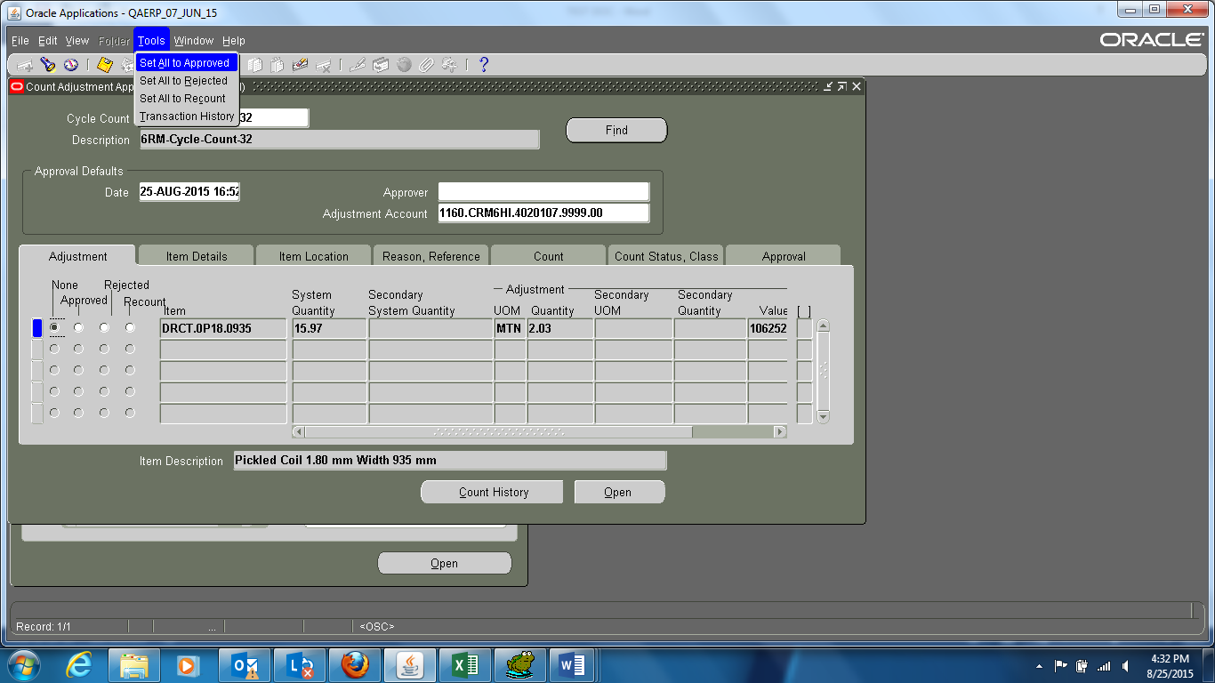
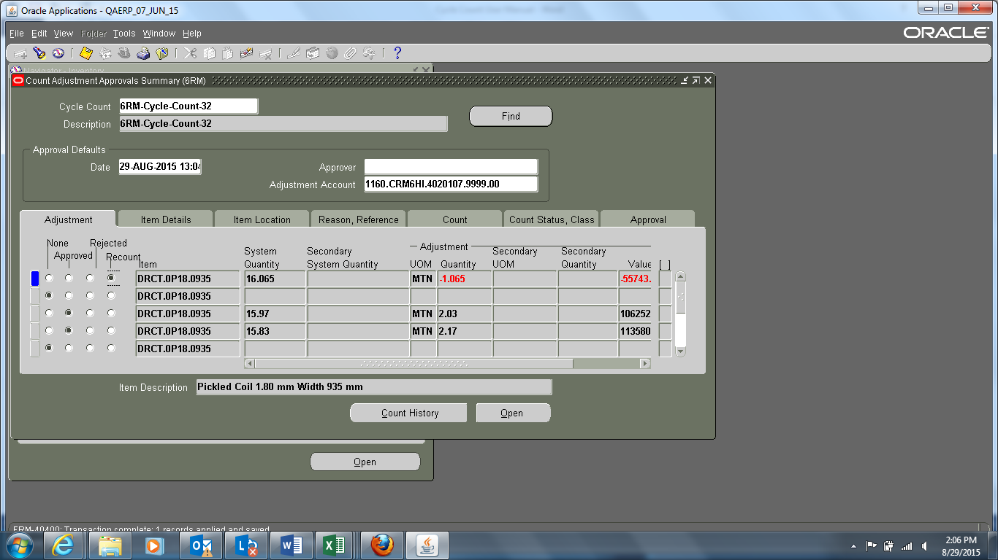
CYCLE COUNTING – APPROVAL
Count Adjustments and Approvals:
Once cycle counts are entered and saved, Oracle Inventory determines whether any adjustments need to be made depending on the approval options and tolerances set when the cycle count is defined.
Use flexible search criteria to specify the cycle count adjustments to be reviewed or approved.

Slide 15
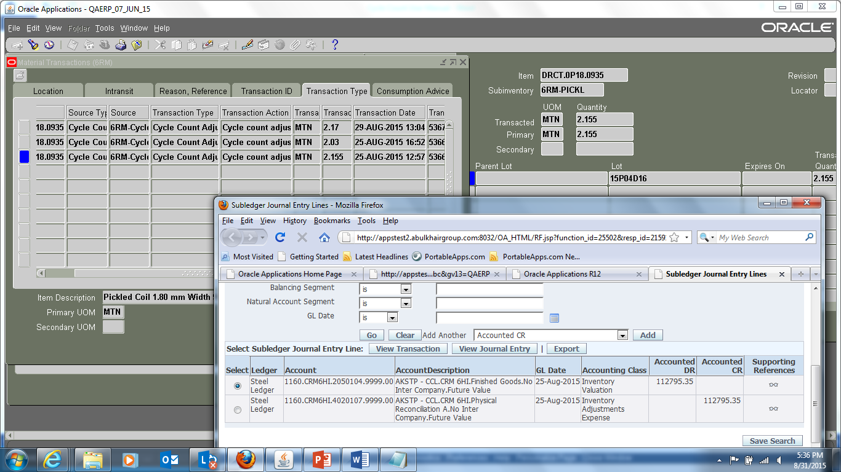
CYCLE COUNTING - ACCOUNTING
Transaction & Accounting:

Slide 16
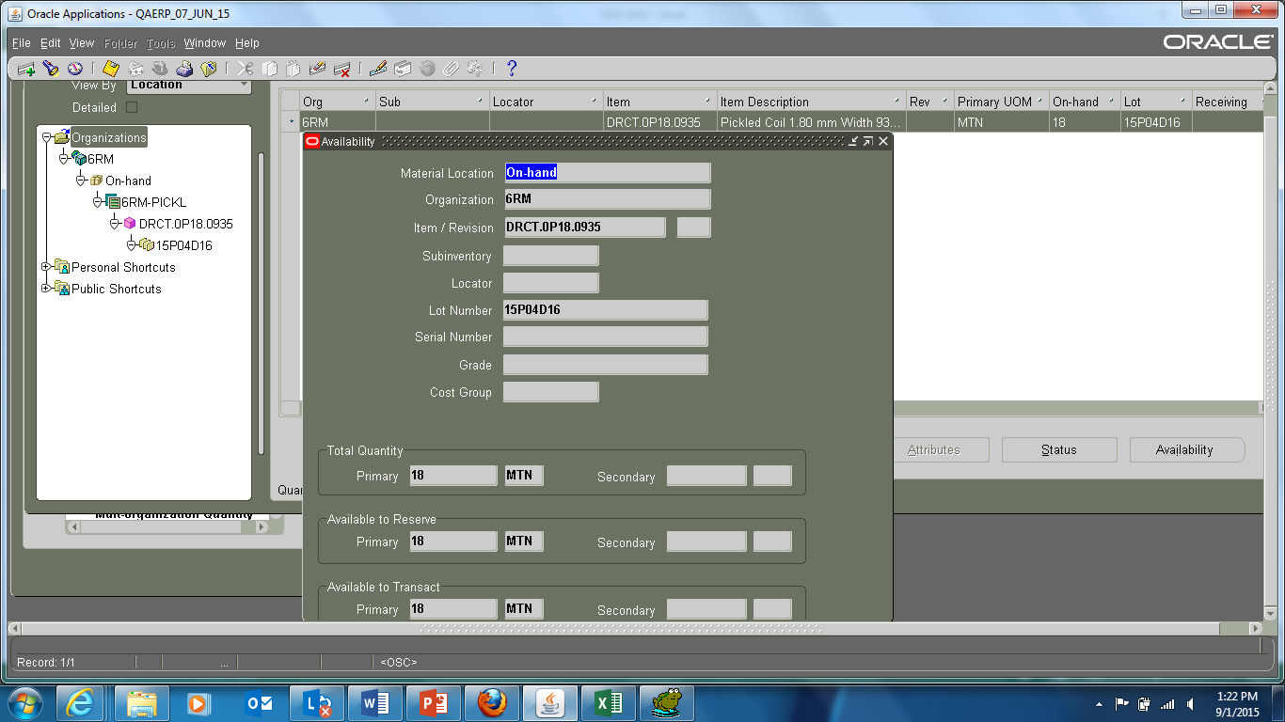
CYCLE COUNTING – ON HAND
STOCK - ON HAND:

Slide 17
CYCLE COUNTING - EXAMPLE
Example:
An example related to the setup of ‘ABC’ Cycle Count Schedule is illustrated below:
For example: a firm has 300 ‘A’ class items, they want to count the ‘A’ class items 12 times per year. They would like to set up the system so that each month the system automatically selects ‘A’ class items (in the example it would be 10 items/day) and prints a daily cycle count request the first day of the month.
They then want the system to generate another list of ‘A’ class items for Day 2 etc. The process would be repeated daily until all ‘A’ class items are cycle counted each month.
The setup is as follows:
1. Add all 300 items to class ‘A’
2. Make Counts per year for class ‘A’ = 12
3. Automatic schedule for 'Daily'.
The above set up would ensure all the 300 items to be counted once over a period of one month.

Slide 18
THANK YOU
© [year] [legal member firm name], a [jurisdiction] [legal structure] and a member firm of the KPMG network of independent member firms affiliated with KPMG International Cooperative, a Swiss entity. All rights reserved.
The KPMG name, logo and “cutting through complexity” are registered trademarks or trademarks of KPMG International.

